Slide 1
Multi-agent Reinforcement Learning for Networked System Control
Literature review 13

Slide 2
Contents
1
Motivation
2
Methodology

Slide 3
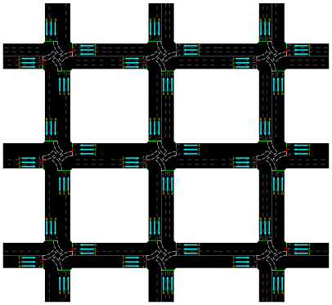
1 Motivation
Theme: Multi-agent Reinforcement Learning
Application: Networked system
Idea: Spatial-temporal Markov Decision Process
Highlights: spatial consideration & communication

Slide 4
1 Motivation
Multi-agent Reinforcement Learning
Without communication (MADDPG, COMA)
Share parameters
Centralized critic + decentralized actors
With communication
Direct information sharing
Transfer the low-dimensional policy feature
Learnable communication protocol
Transfer the signal that is learned during training
Attention-based
Focus on selecting which agents to communicate

Slide 5
2 Methodology
Spatial-temporal RL

Slide 6
2 Methodology
Spatial-temporal RL

Slide 7
2 Methodology
Spatial-temporal RL

Slide 8




2 Methodology
Spatial-temporal RL
Single agent
Multi agent
$$p(s_{t+1}|s_{t},a_{t})$$
$$p_{i}(s_{t+1}^{i}|s_{t},a_{t})$$
or
$$p_{i}(s_{t+1}^{i}|s_{t}^{i},a_{t}^{i})$$
Multi agent with Spatial-temporal MDP
$$p_{i}(s_{t+1}^{i}|s_{t}^{𝒱_{i}},a_{t}^{𝒱_{i}})$$

Slide 9
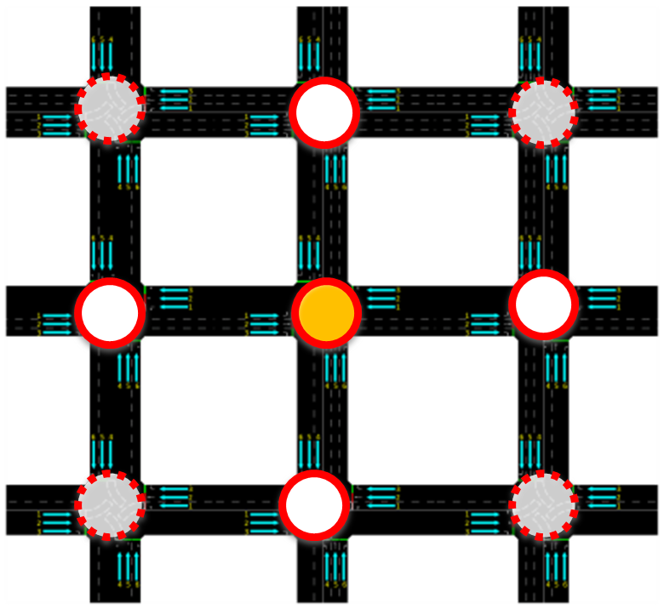
2 Methodology
Spatial-temporal RL
Single agent
Multi agent
$$p(s_{t+1}|s_{t},a_{t})$$
$$p_{i}(s_{t+1}^{i}|s_{t},a_{t})$$
or
$$p_{i}(s_{t+1}^{i}|s_{t}^{i},a_{t}^{i})$$
Multi agent with Spatial-temporal MDP
$$p_{i}(s_{t+1}^{i}|s_{t}^{𝒱_{i}},a_{t}^{𝒱_{i}})$$
1) Local transitions are independent of other agents given the neighboring agents.

Slide 10

2 Methodology
Spatial-temporal RL
Single agent
Multi agent
$$p(s_{t+1}|s_{t},a_{t})$$
$$p_{i}(s_{t+1}^{i}|s_{t},a_{t})$$
or
$$p_{i}(s_{t+1}^{i}|s_{t}^{i},a_{t}^{i})$$
Multi agent with Spatial-temporal MDP
$$p_{i}(s_{t+1}^{i}|s_{t}^{𝒱_{i}},a_{t}^{𝒱_{i}})$$
1) Local transitions are independent of other agents given the neighboring agents.
2) Personal reward is based on neighbors.

Slide 11

2 Methodology
Spatial-temporal RL
Decentralized actor-critic framework
Environment
Action
Action
Immediate
feedback
Actor
Actor
Evaluation
Evaluation
Critic
Critic
$$⋯$$
Agent 1
Agent n

Slide 12
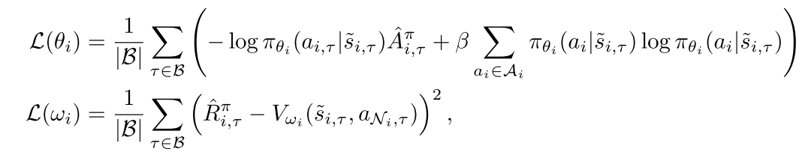
2 Methodology
Spatial-temporal RL
Decentralized actor-critic framework
Environment
Action
Action
Immediate
feedback
Actor
Actor
Evaluation
Evaluation
Critic
Critic
$$⋯$$
Agent 1
Agent n

Slide 13
2 Methodology
Spatial-temporal RL
Decentralized actor-critic framework
Environment
Action
Action
Immediate
feedback
Actor
Actor
Evaluation
Evaluation
Critic
Critic
$$⋯$$
Agent 1
Agent n

Slide 14
2 Methodology
Spatial-temporal RL
Decentralized actor-critic framework
Environment
Action
Action
Immediate
feedback
Actor
Actor
Evaluation
Evaluation
Critic
Critic
$$⋯$$
Agent 1
Agent n

Slide 15
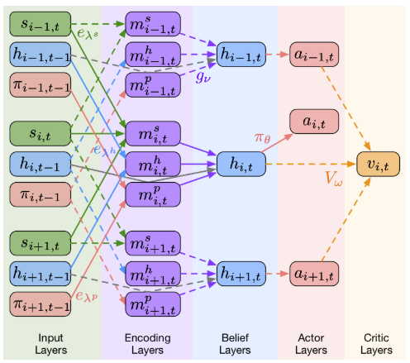
2 Methodology
Spatial-temporal RL
Neural Communication

Slide 16
2 Methodology
Spatial-temporal RL
Neural Communication
Forward process of actors: produce action
Actors’ job

Slide 17
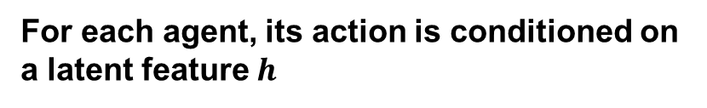
2 Methodology
Spatial-temporal RL
Neural Communication
For each agent, its action is conditioned on a latent feature $h$
Actors’ job

Slide 18
2 Methodology
Spatial-temporal RL
Neural Communication
Actors’ job

Slide 19

2 Methodology
Message from all the state observation of each agent
$$m_{i,t}^{s}$$
Spatial-temporal RL
Neural Communication
Actors’ job

Slide 20

2 Methodology
Message from last belief of neighbor agents
$$m_{i,t}^{h}$$
Spatial-temporal RL
Neural Communication
Actors’ job

Slide 21

2 Methodology
Message from policy of neighbor agents
$$m_{i,t}^{p}$$
Spatial-temporal RL
Neural Communication
Actors’ job

Slide 22
2 Methodology
For each agent, the evaluation of its current state is based on the action from neighbor agents and its own belief
Spatial-temporal RL
Neural Communication
Critics’ job

Slide 23
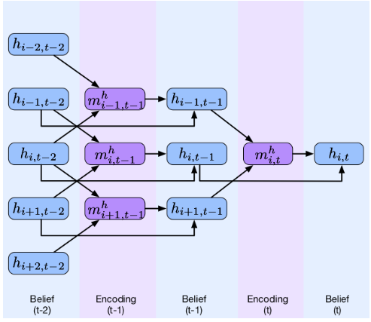
2 Methodology
The belief can be modelled on multiple steps
Spatial-temporal RL
Neural Communication

Slide 24
2 Methodology
Spatial-temporal RL
Neural Communication
All the message is parametrized to become learnable, thus it is basically can generalize many up-to-date communication based MARL framework
Not sure whether such a massive model is efficient given sparse reward signal.

Slide 25
Thank you for watching !

